Slide 1


Slide 2
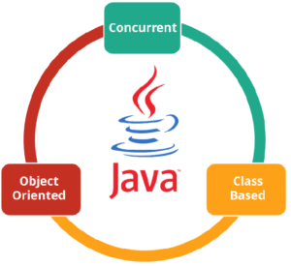
What is JAVA ?
Independent programming language that follows the logic of “Write once, Run anywhere”
Class-based and an object-oriented programming language.
Concurrent where you can execute many statements

Slide 3
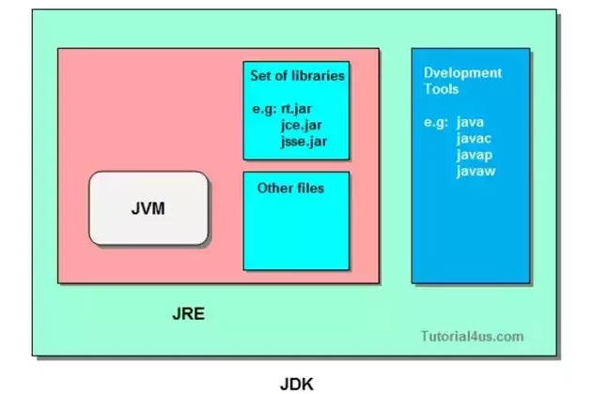
Components Of Java
JVM (Java Virtual Machine)
JRE (Java Runtime Environment)
JDK(Java Development Kit)

Slide 4
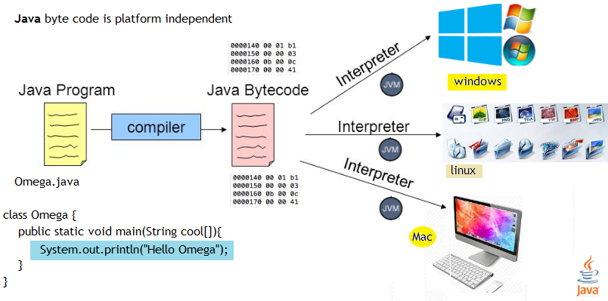
Java – Platform Independent

Slide 5
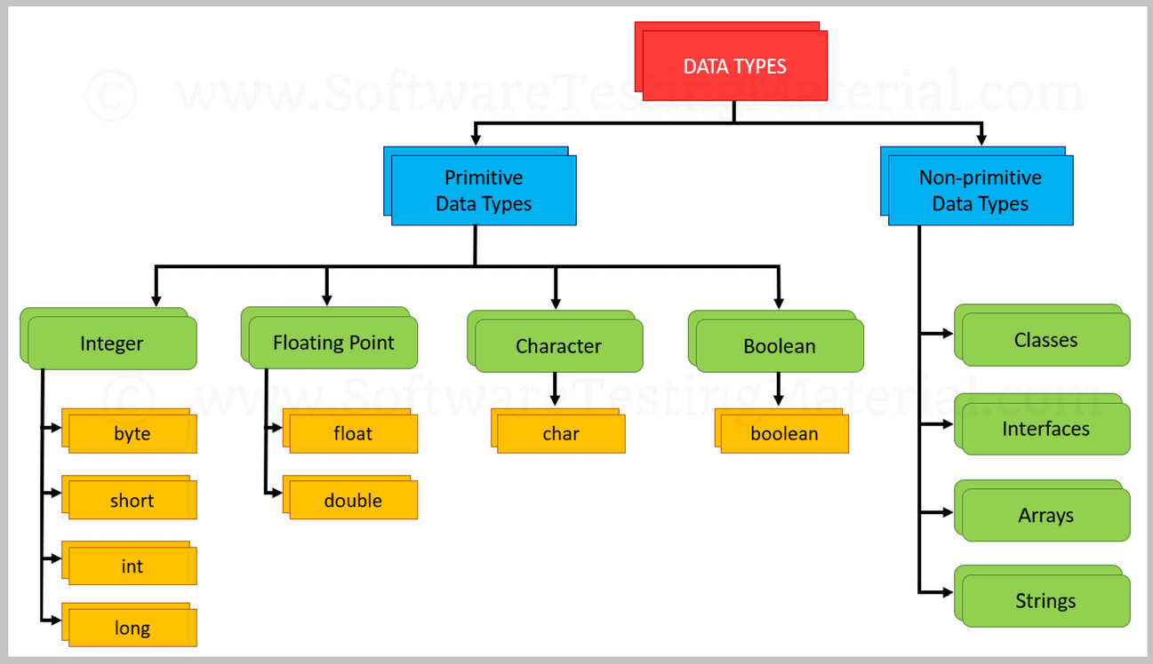
Java – Data Types

Slide 6
Java – My First HelloWorld Program
public class HelloWorld{
public static void main(String[] args) {
System.out.println(“Hello Welcome");
}
}

Slide 7
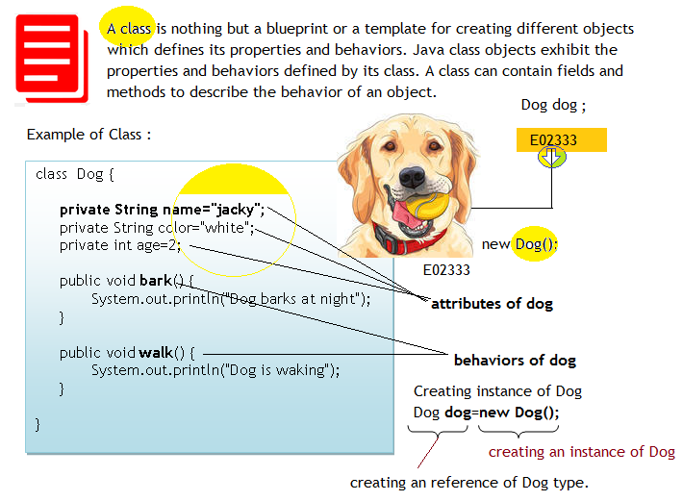
Java – Class

Slide 8
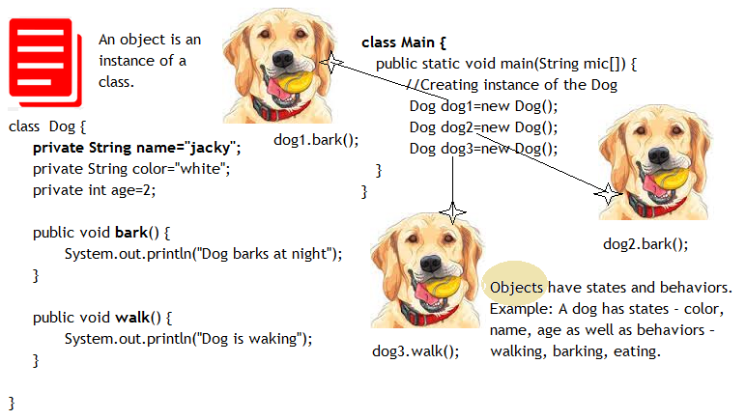
Java – Object

Slide 9
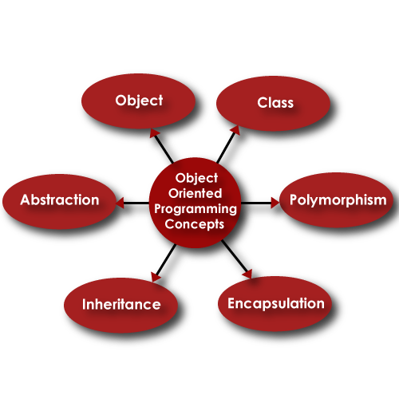
Java – OOPS Features

Slide 10
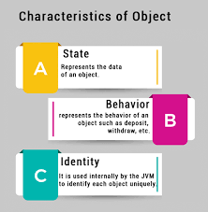
Java – Object

Slide 11
OOPS – Encapsulation
What is encapsulation?
The whole idea behind encapsulation is to hide the implementation details from users. If a data member is private it means it can only be accessed within the same class. No outside class can access private data member (variable) of other class.
Benefits of encapsulation
Provides abstraction between an object and its clients.
Protects an object from unwanted access by clients.

Slide 12
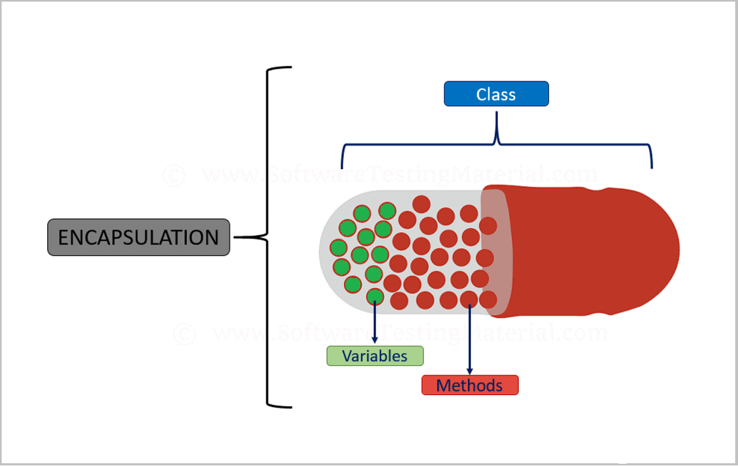
OOPS – Encapsulation

Slide 13
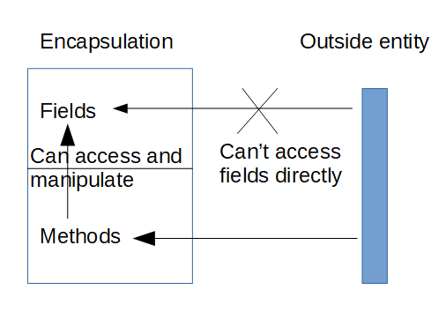
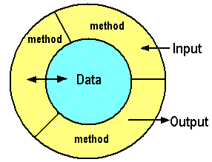
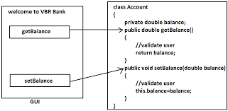

Slide 14
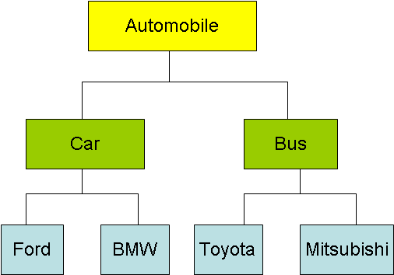
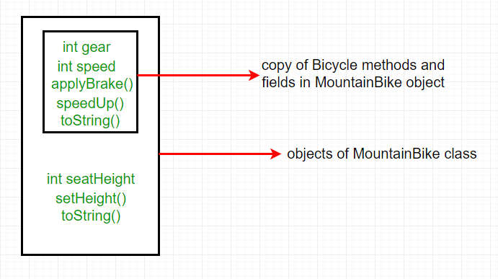
OOPS – Inheritance
Important terminology: Super Class: The class whose features are inherited is known as super class(or a base class or a parent class).
Sub Class: The class that inherits the other class is known as sub class(or a derived class, extended class, or child class). The subclass can add its own fields and methods in addition to the super class fields and methods.
Reusability: Inheritance supports the concept of “reusability”, i.e. when we want to create a new class and there is already a class that includes some of the code that we want, we can derive our new class from the existing class. By doing this, we are reusing the fields and methods of the existing class.

Slide 15
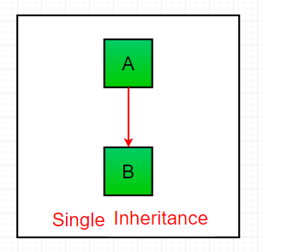
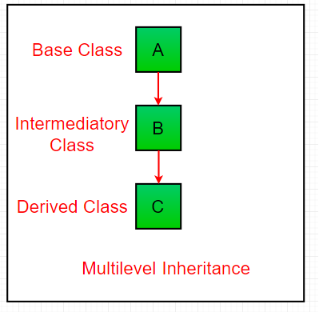
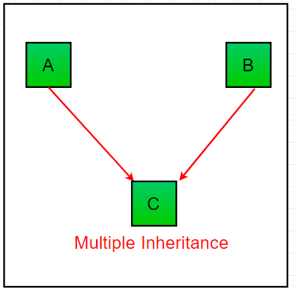
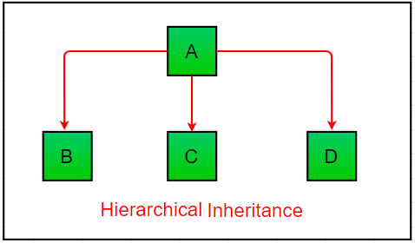
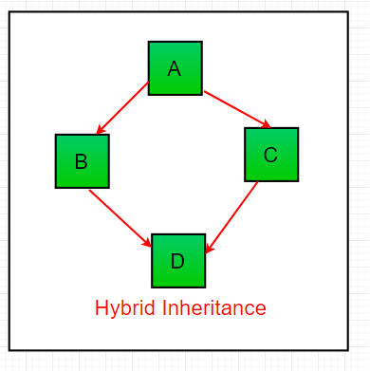
OOPS – Inheritance
Multiple Inheritance:

Slide 16
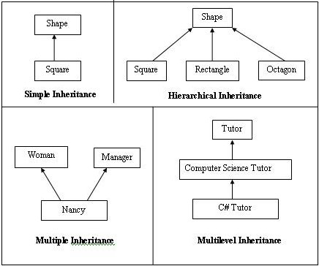
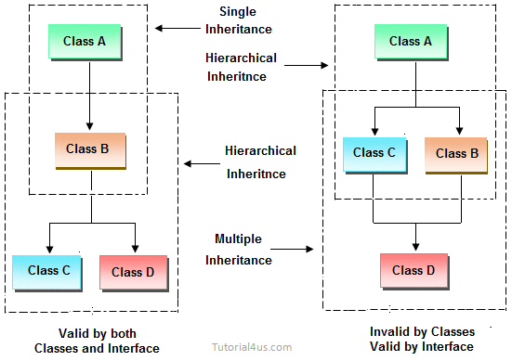
OOPS – Inheritance

Slide 17
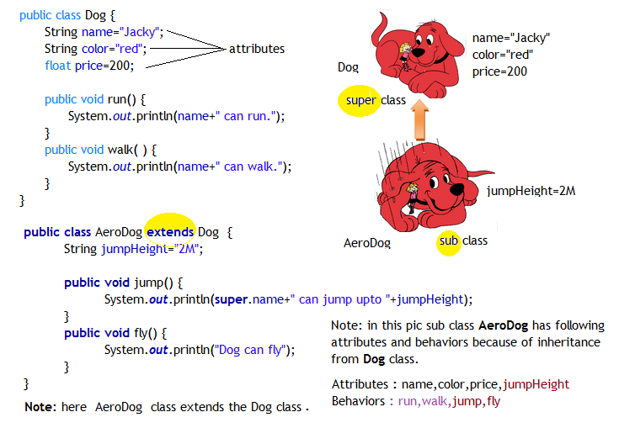
OOPS – Inheritance

Slide 18
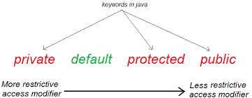
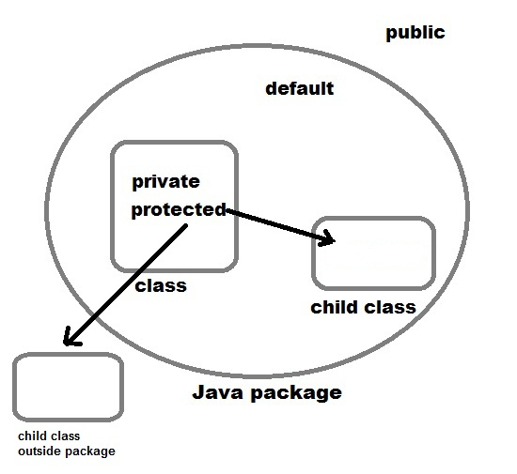
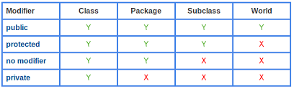
OOPS – Access Modifier

Slide 19
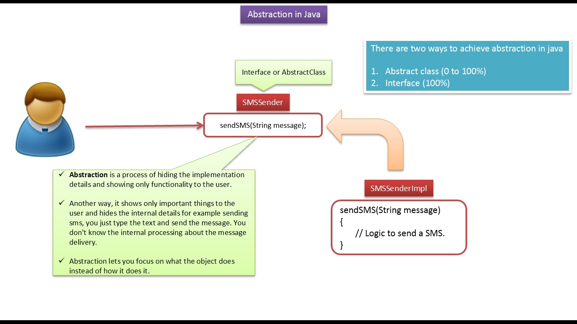
OOPS – Abstraction

Slide 20
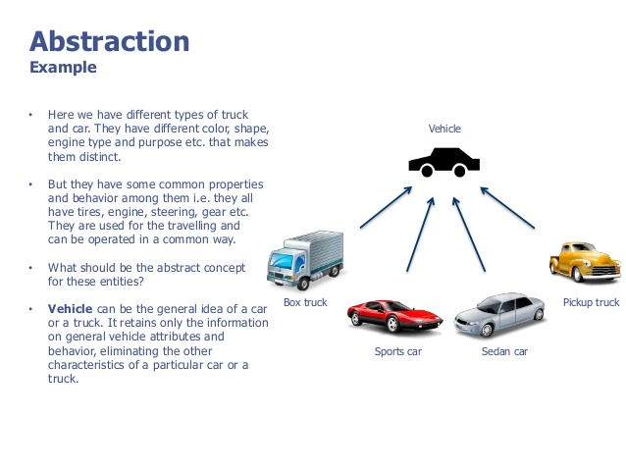
OOPS – Abstraction

Slide 21
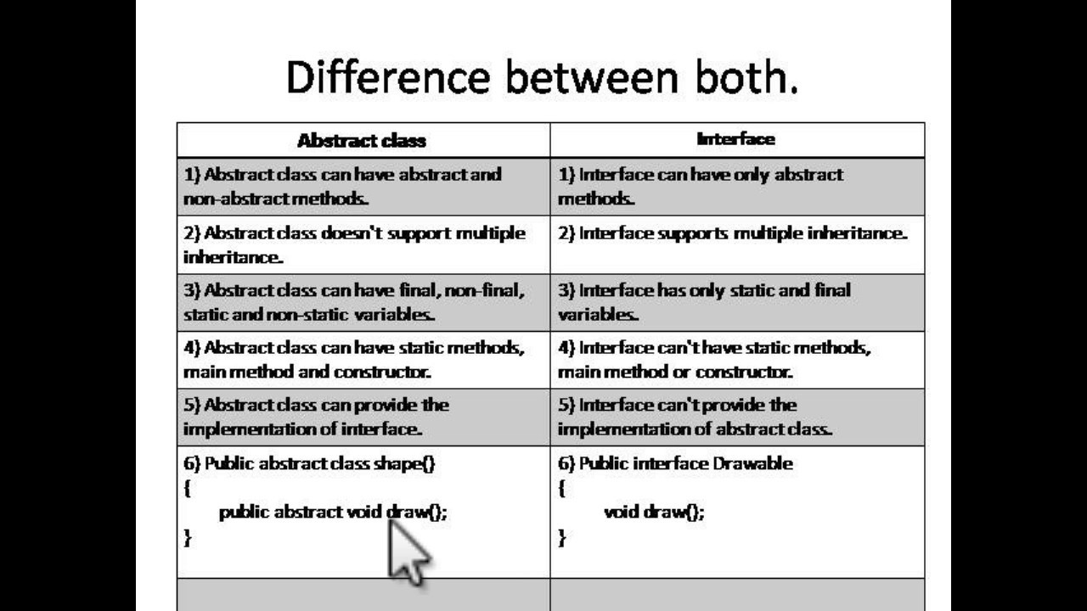
OOPS – Abstract Vs Interface

Slide 22
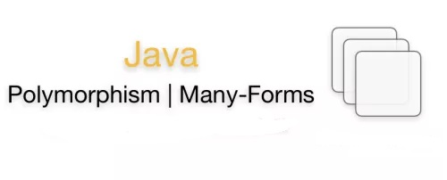

Slide 23
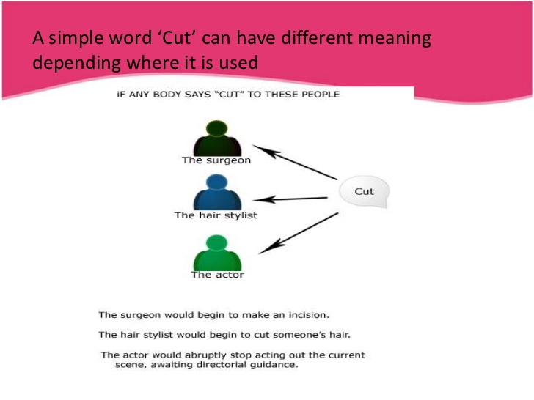
OOPS – Polymorphism

Slide 24
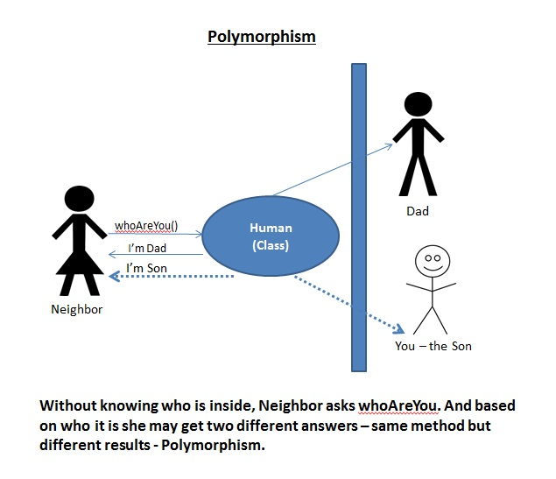
OOPS – Polymorphism

Slide 25
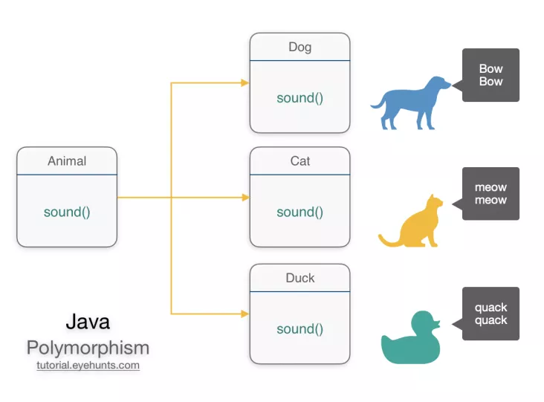
OOPS – Polymorphism

Slide 26
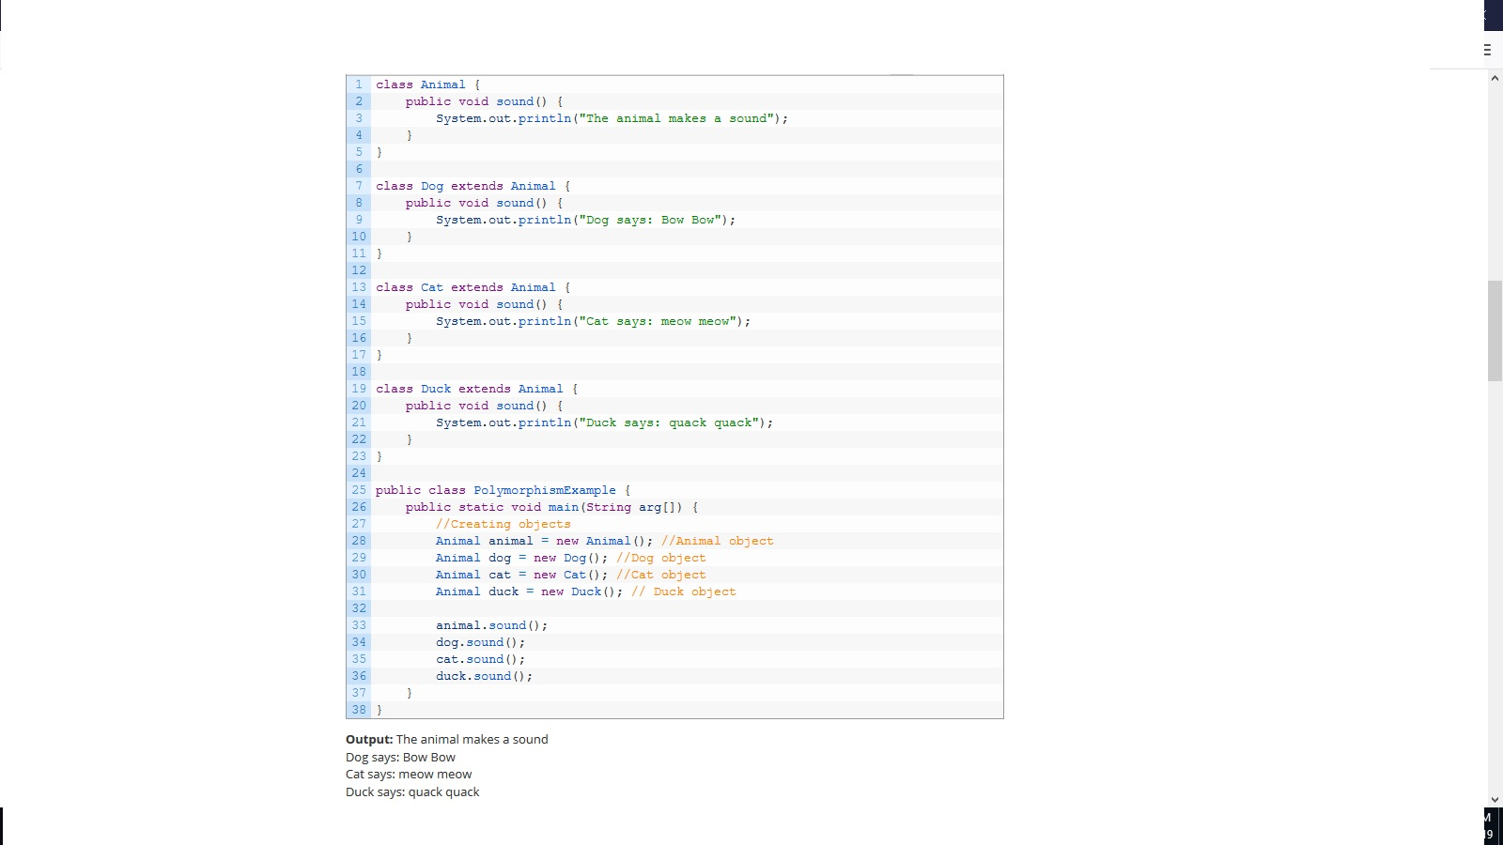
OOPS – Polymorphism

Slide 27
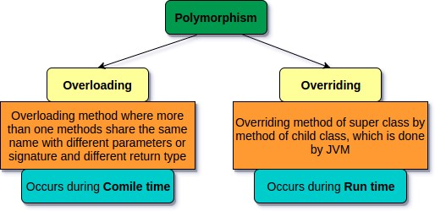
OOPS – Polymorphism

Slide 28
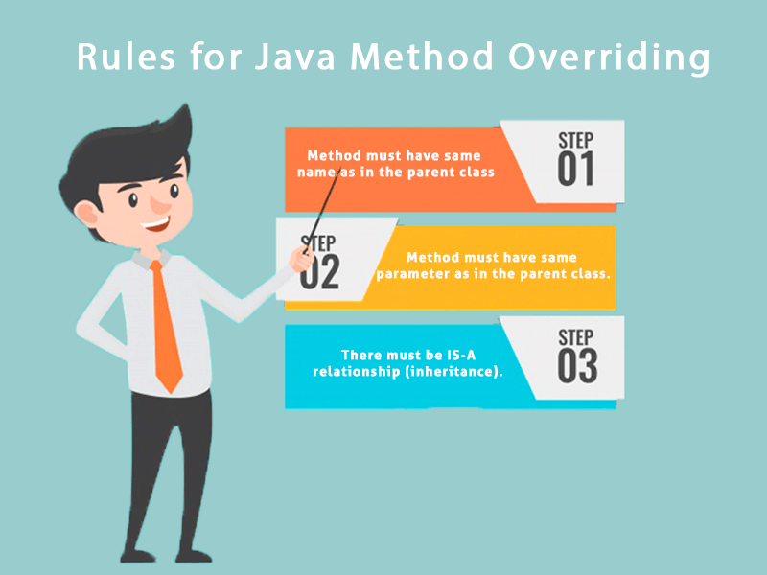
OOPS – Polymorphism - Overridding

Slide 29
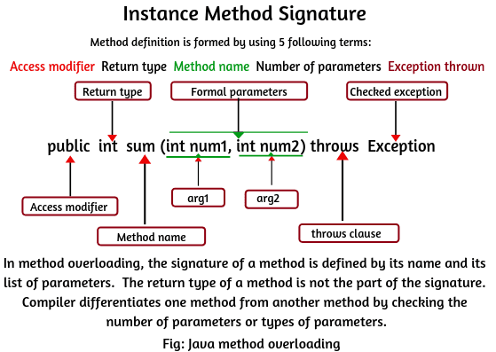
OOPS – Polymorphism - Overloading

Slide 30


